Slide 1

IST 687 – Final Project Forecasting High-Cost Healthcare Clients
By Tarun Talreja, Yash Wadhawe, Maulik Ramnani, Dev Jindani, Achala Rao, and Aditya Kulkarni | Group 3

Slide 2

Background - Healthcare

Slide 3



Project Goal:
The goal for our team is to understand the key drivers for why some people are more expensive (i.e. require more health care), as well as predict which people will be expensive (in terms of health care costs).
Hence, we have two goals:
Predict people who will spend a lot of money on health care next year (i.e., which people will have high healthcare costs).
Provide actionable insight to HMO, in terms of how to lower their total health care costs, by providing a specific recommendation.

Slide 4
Dataset Overview
7582
The dataset contains healthcare cost information for each person including their age, gender, BMI, number of children, smoking status, region, and healthcare costs.
The dataset has 7582 rows and 14 columns.

Slide 5

Project Deliverables
The analysis includes exploratory Data analysis (EDA) (e.g. histograms, scatter plots), and implementation of several machine learning Algorithms to predict customer’s expensive status.

Slide 6

Exploratory Data Analysis

Slide 7
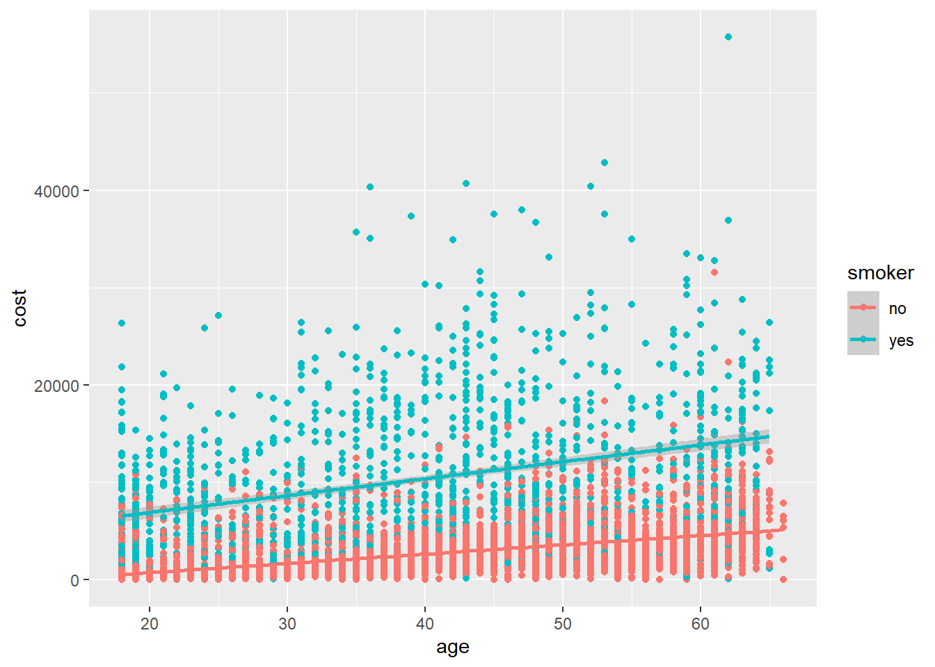
Age v/s Cost (smoker)

Slide 8
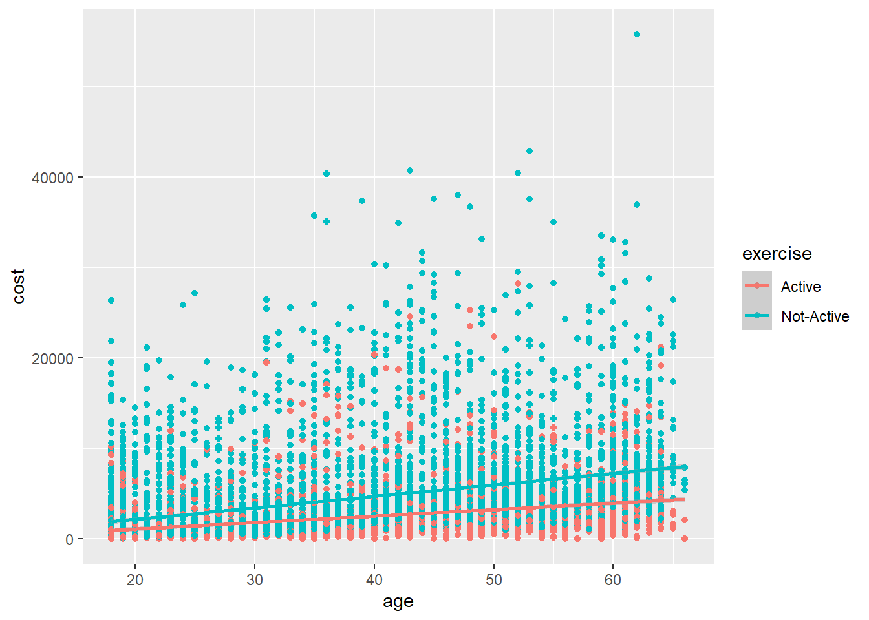

Age v/s Cost (exercise)

Slide 9
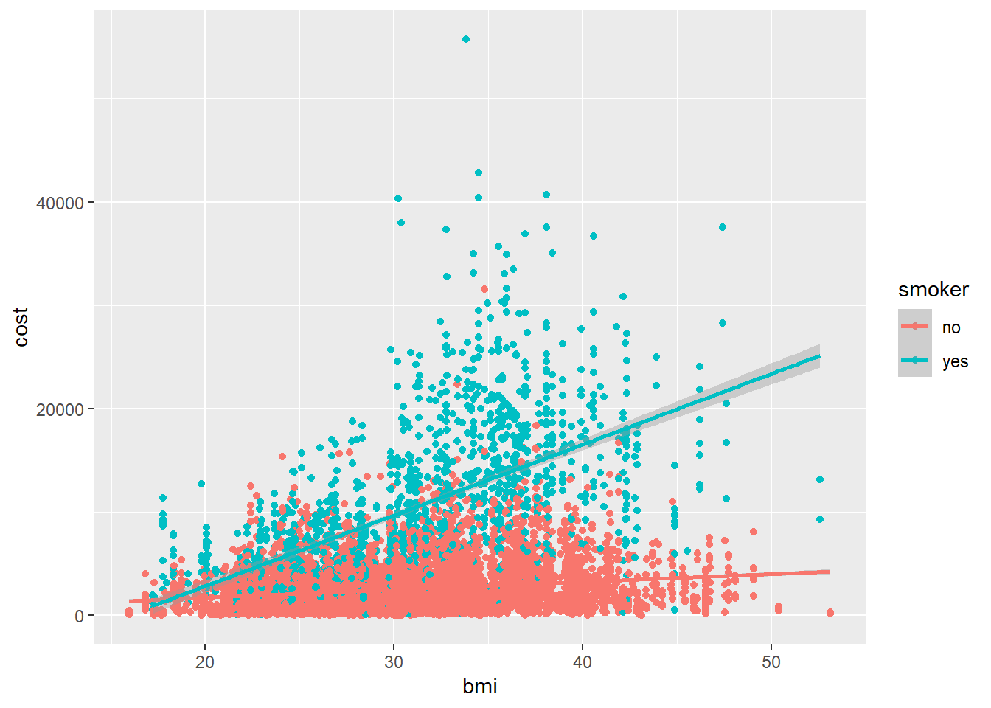
BMI v/s Cost (smoker)

Slide 10
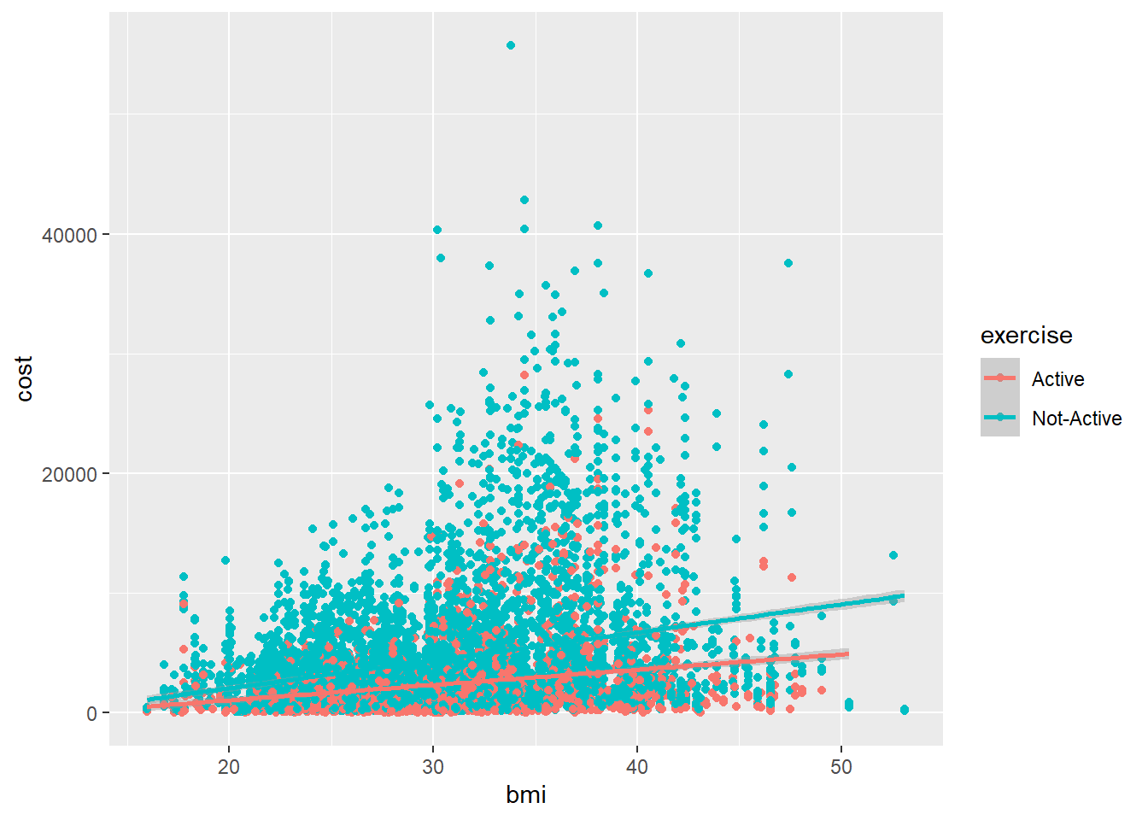
BMI v/s Cost (Exercise)

Slide 11

Our Interpretation
The provided plots show how healthcare costs are correlated with age and BMI for different smoking and exercise habits.
For smokers, healthcare costs tend to increase with age, indicating a positive correlation between age and healthcare costs.
People who are inactive have higher healthcare costs and there are some anomalies in the data for active individuals when considering age and healthcare costs.
BMI has a positive correlation with healthcare costs, with a stronger correlation for smokers. People who have high BMI and smoke are most likely to have higher healthcare costs.
Individuals with an inactive lifestyle tend to have higher healthcare costs, while there are some anomalies in the data for active individuals when considering the correlation between BMI and healthcare costs.

Slide 12
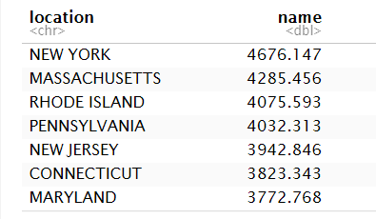
Highest Healthcare Cost by State

Slide 13
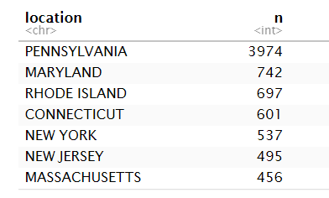
State wise count

Slide 14

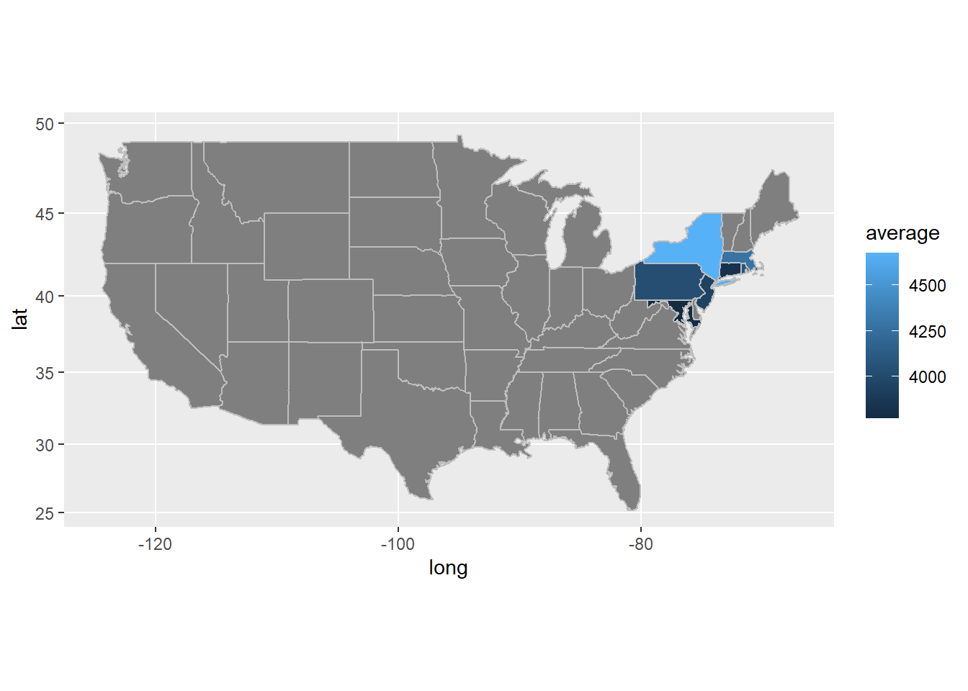
Average Cost v/s Location Map

Slide 15

Prediction Model
It is evident that age bmi and smoking has a positive correlation with healthcare cost of a customer. Children doesn’t have a strong correlation with cost.
Now that we have an attribute that identifies expensive healthcare, we can generate a predictive model

Slide 16

Support Vector Machine

Slide 17
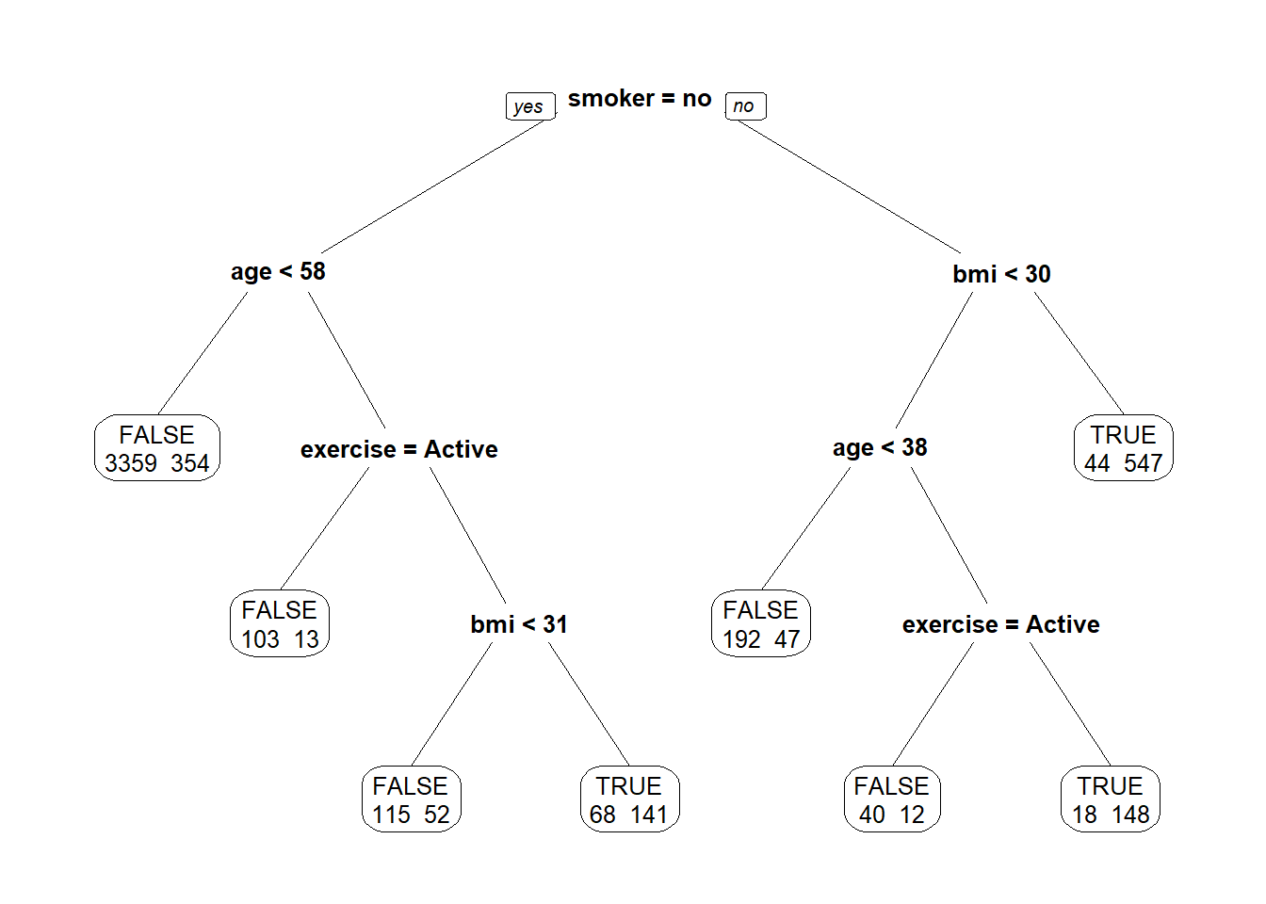
Decision Tree

Slide 18

We also need to find trends on why health care costs a subset of customers expensive.

Slide 19
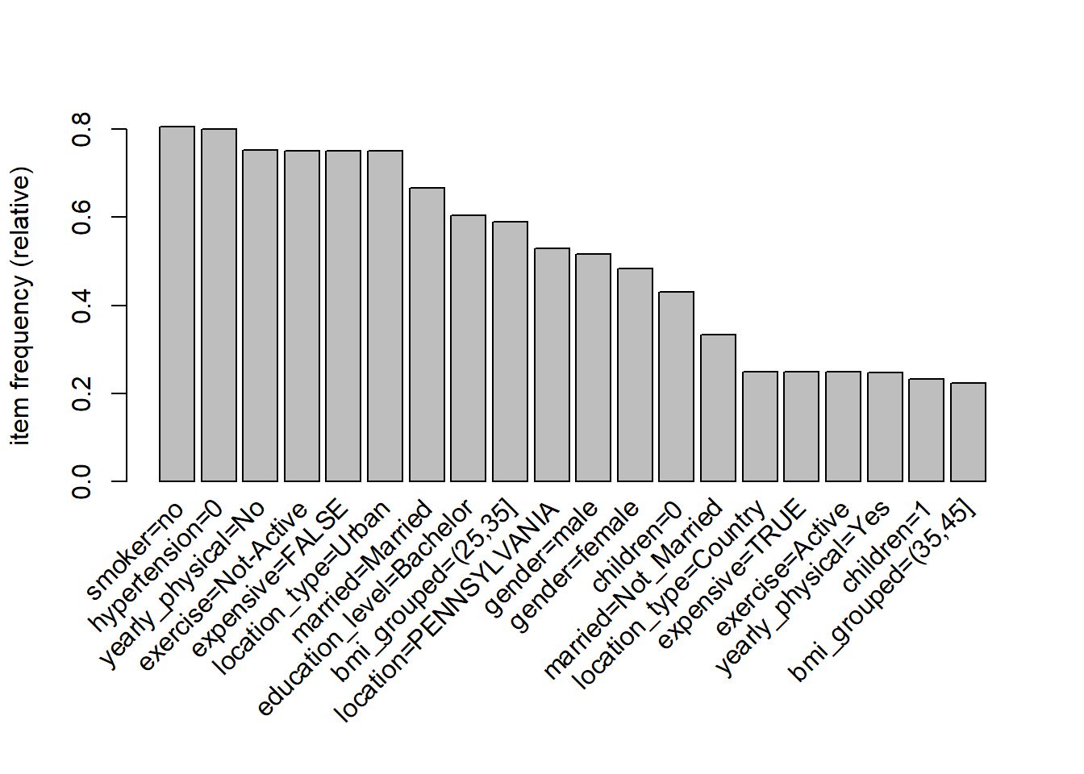
Item Frequency

Slide 20
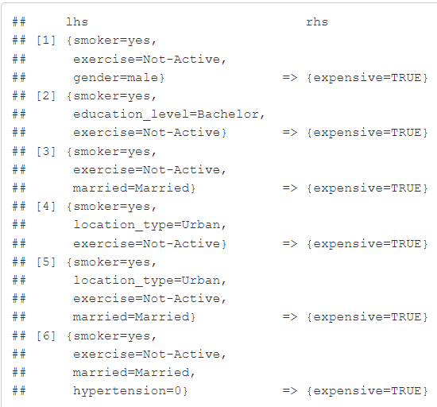
Association Rules

Slide 21


Conclusion
Predict people who will spend a lot of money on health care next year (i.e., which people will have high healthcare costs).
Provide actionable insight to the HMO, in terms of how to lower their total health care costs, by providing a specific recommendation on how to lower health care costs.

Slide 22

Thank you!

